Slide 1
Database Performance Tuning
Copyright 2021-2022 Warren Mansur. Permission granted for any use of Boston University.

Slide 2

The Driving Factor - Expectations
Notes:
The end users want their tasks to be fast, regardless of how many layers are present in the system.
The general rule is that the application must respond, start to finish, in 3 seconds or less.

Slide 3

Performance Bottlenecks
Notes:
When there are performance issues, identification of the bottleneck is crucial.
There may be more than one bottleneck in immature systems.
Bottlenecks may be present in any layer, and there may be more than one bottleneck in a single layer.

Slide 4
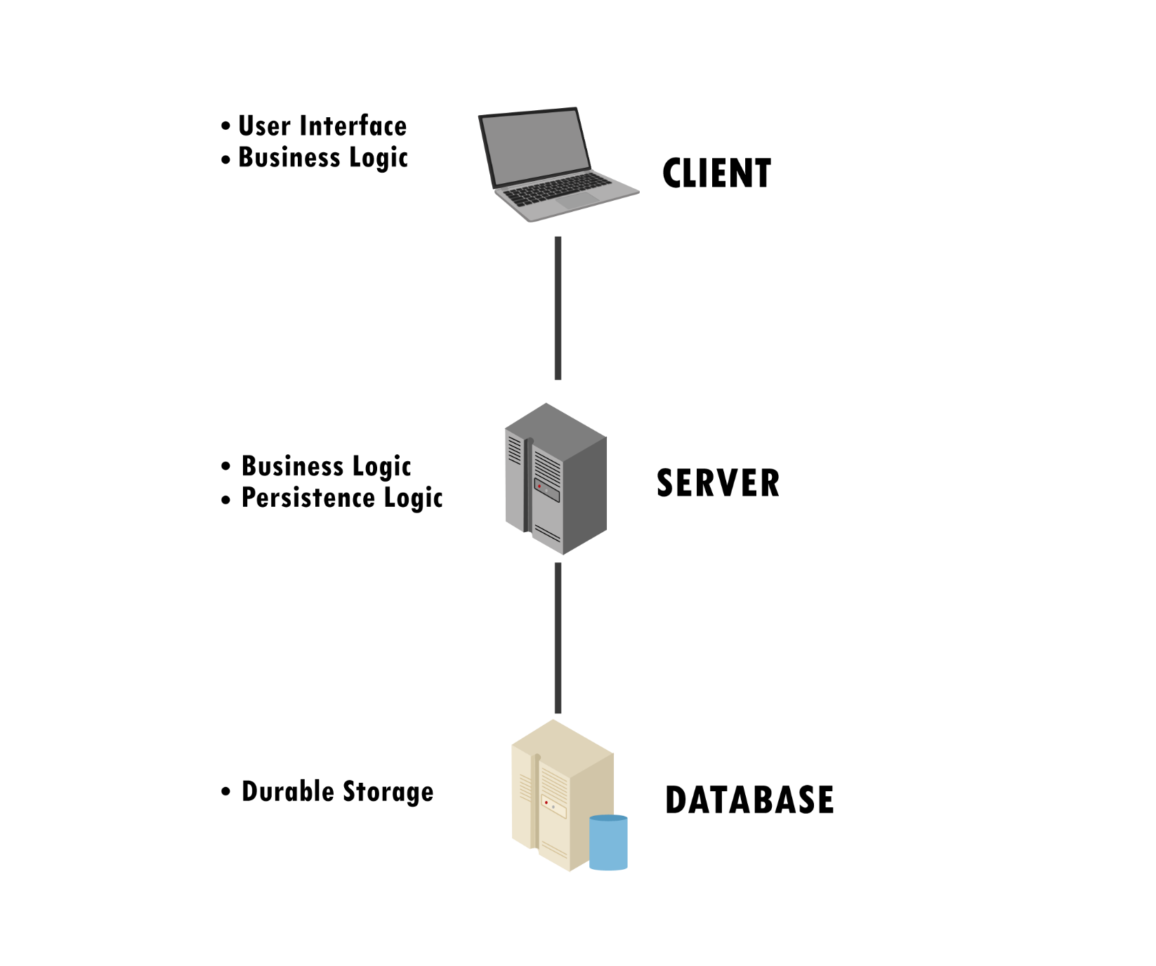
2-tier Client-Server Architecture

Slide 5
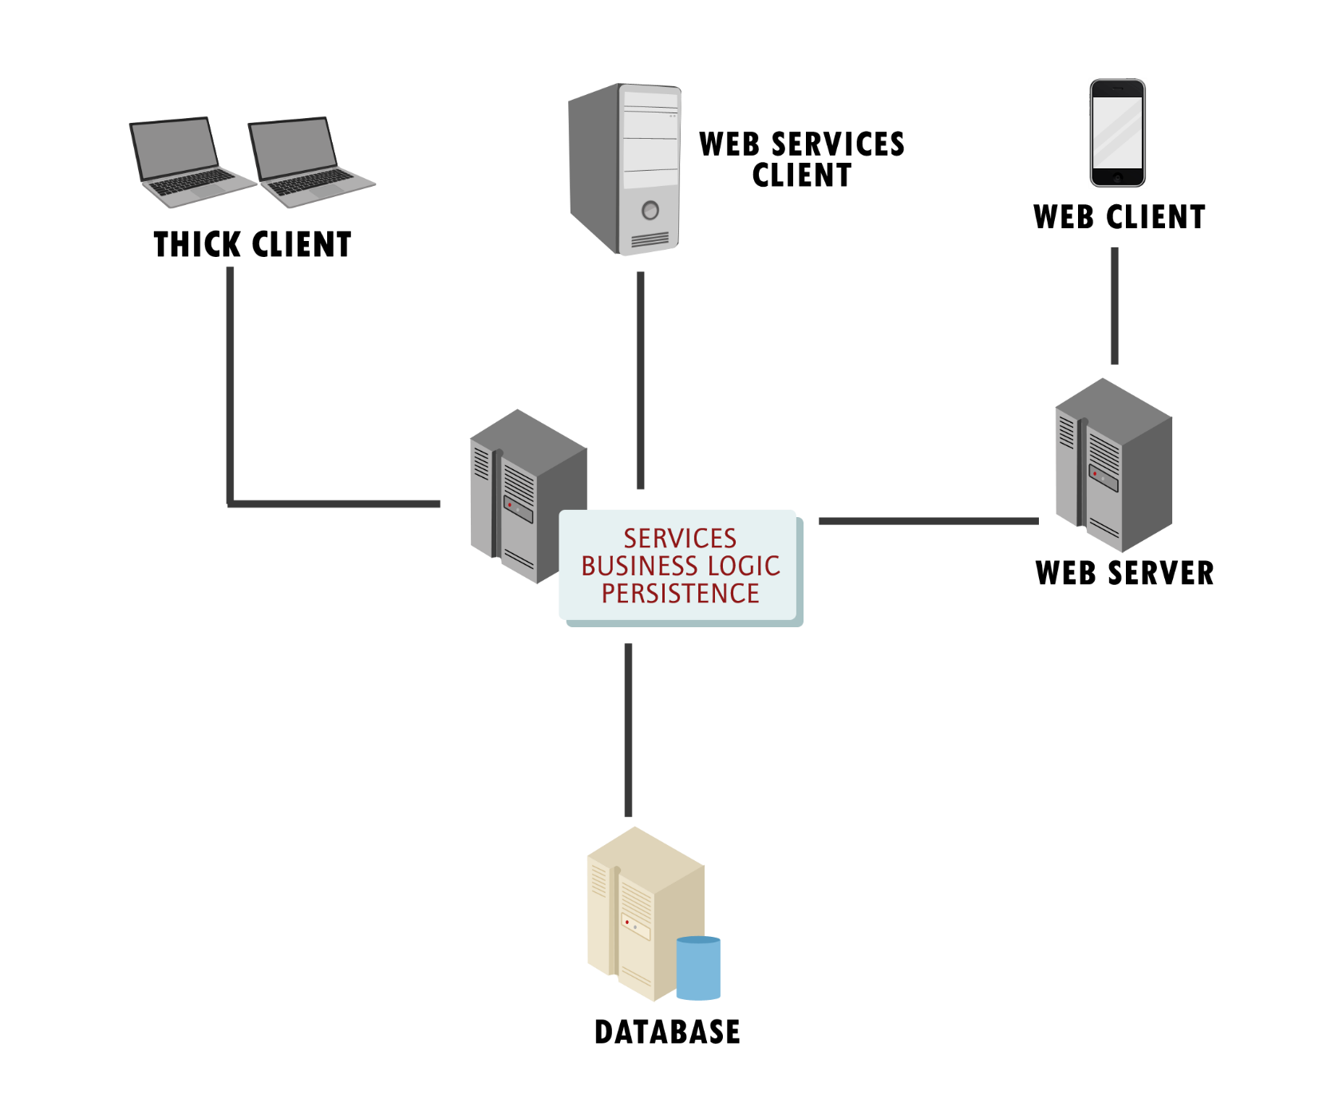
N-Tier Client-Server Architecture

Slide 6
Database Performance Strategies
Most important, create indexes, which are constructs designed to speed up queries.
Implement a data retirement strategy.
Denormalize judiciously.

Slide 7
Data Retirement
Data in operational systems does not necessarily need to live it the database indefinitely.
Relevant data can be saved in data warehouses and data lakes and then deleted from the operational system.

Slide 8
Denormalization
Normalization oftentimes decreases performance. Denormalization oftentimes increases performance.
Merge entities related with 1:1 relationships.
Duplicating attributes in entities related with 1:M and M:N (through a bridging entity) relationships.
Enumerating in place of using a domain table.

Slide 9
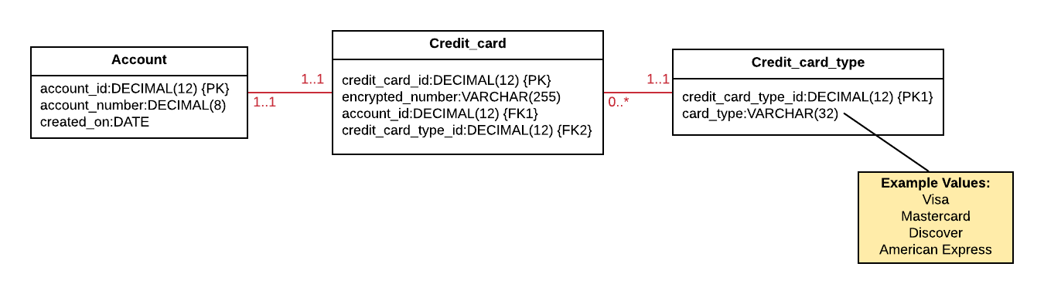
Simple Credit Card Schema

Slide 10
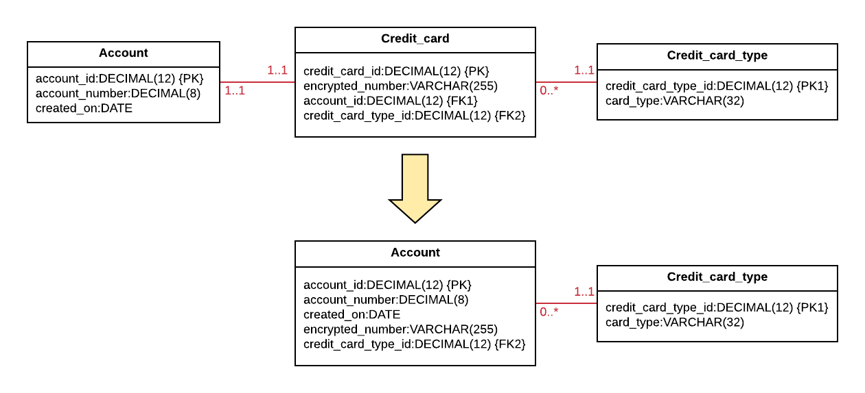
Merging Entities with 1:1 Relationships
Notes:
Better performance and conceptually simpler
Safe unless each entity has its own distinct set of relationships

Slide 11
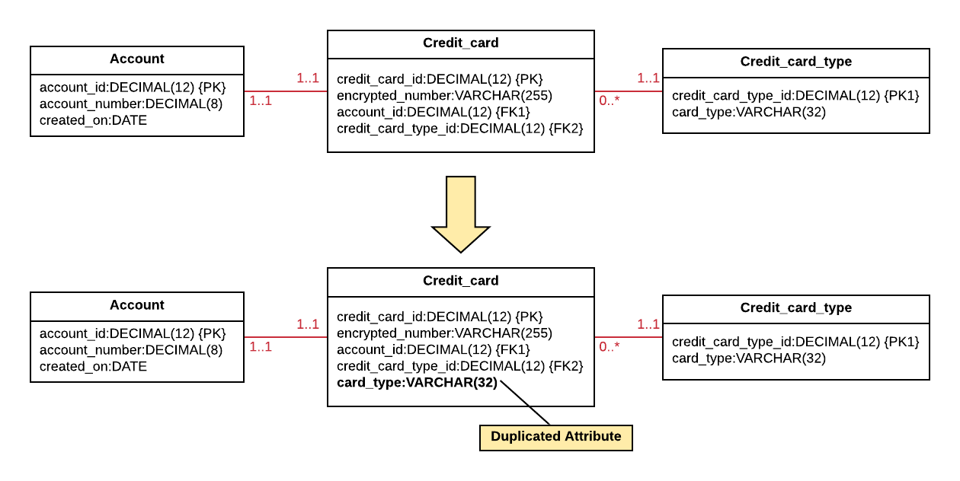
Duplicating Attributes
Notes:
Increased risk of data anomalies but better performance
Use when the duplicated attribute is unlikely to change over time

Slide 12
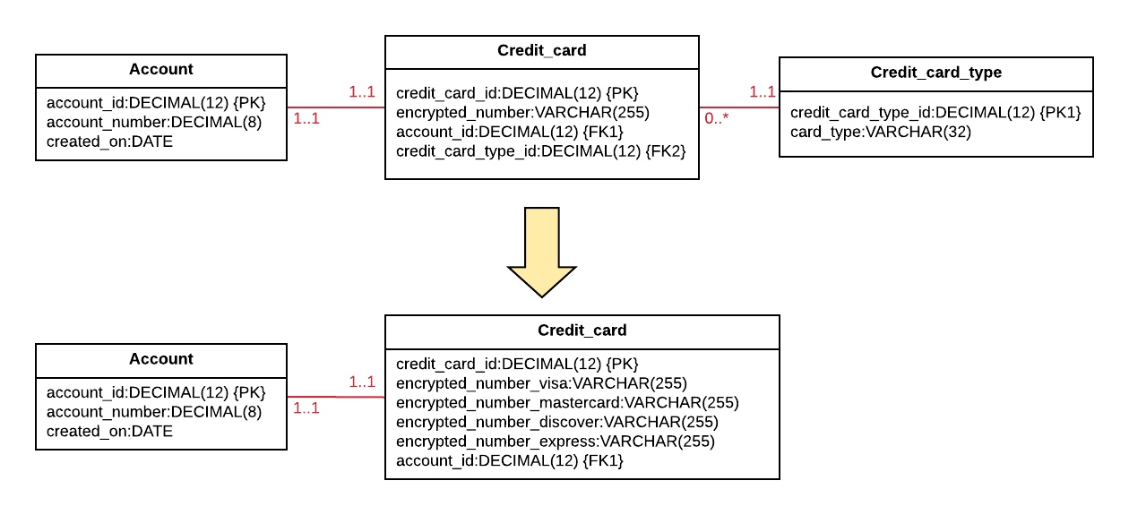
Creating Enumerations
Notes:
Increased null usage but better performance
Use when the number of options is reasonably small and the number of options is unlikely to change

Slide 13
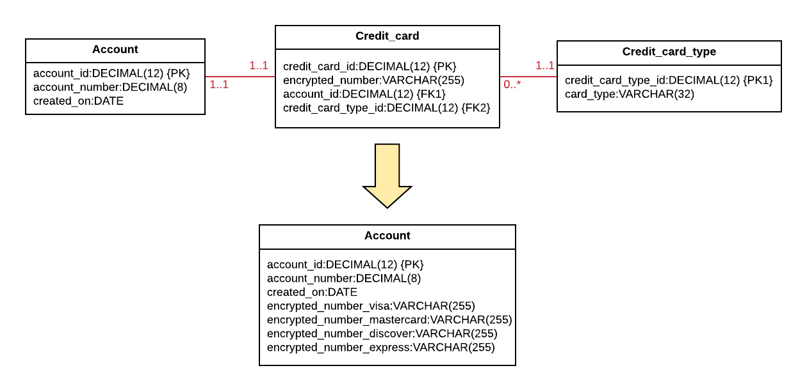
Combining Methods

Slide 14
References
Rob, P. & Coronel, C. (2009). Database Systems: Design, Implementation, and Management. Boston: Course Technology.

Slide 15
End

